Slide 1

Water Quality Economic Impact
MinneAnalytics
Annie Lo Sharon Lin Sophie Zheng Wendy Lu Yurong Fan
R Squad

Slide 2
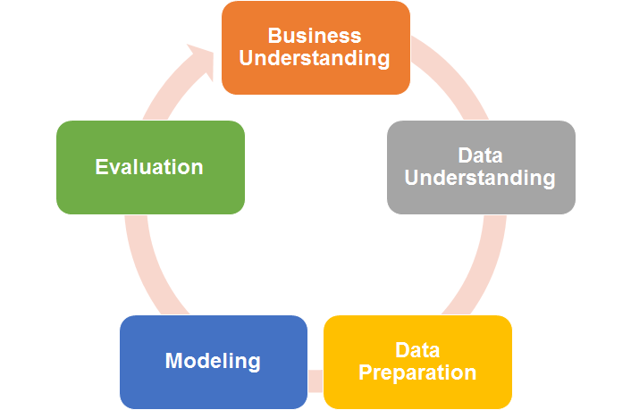
Use an iterative process to tackle large and messy data
Insights & Recommendation
Descriptive Analytics

Slide 3
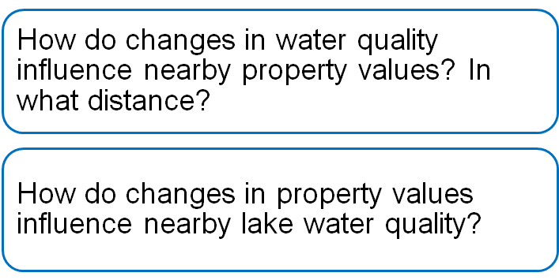

Investigate changes in lake water quality and
property values
By How Much

Slide 4
Data Preparation
Data
Cleaning
Transformation
Water Quality:
Lake Monitoring
Economic Data:
Tax Parcel
Parcel to Lake
Distance
External Factor
Precipitation
Snowfall
Water Quality (>1990)
Missing values
Outliers
Duplicates
Merge parcel and water data
Panel data transformation

Slide 5
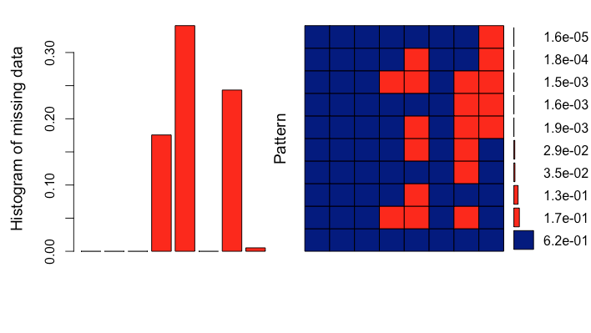
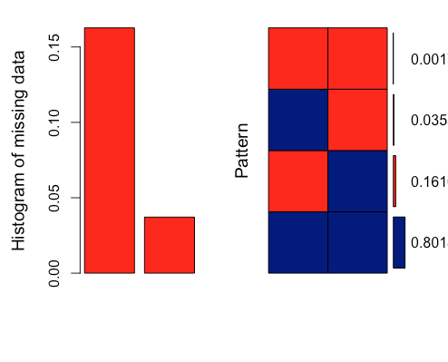
Missing Values
BLDG
LAND
TOTAL
SQFT
GREEN
BUI
LT
USE
SCHOOL
BLDG
LAND
TOTAL
SQFT
GREEN
BUI
LT
USE
SCHOOL
DEPTH
TP
DEPTH
TP
Parcels
Estimated Market Value (EMV): no NA but 0’s that indicate missing
-> Missing not at random - not easy to impute
Lake
Total Phosphorus has the least missing values
-> Easy to impute

Slide 6
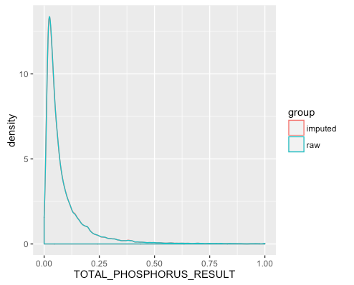
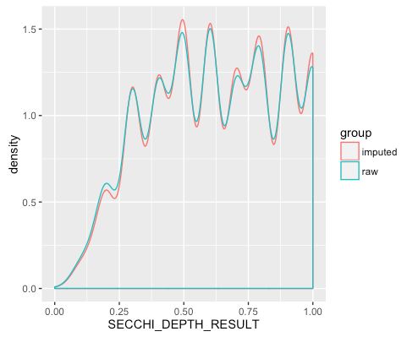
Missing Values (Lake) - Imputation
Use linear regression & predictive mean matching
Response variables: Total Phosphorus / Secchi Depth
Predictors: Year, Lake, Secchi Depth / Total Phosphorus
Use R ‘mice’ package to complete this step

Slide 7
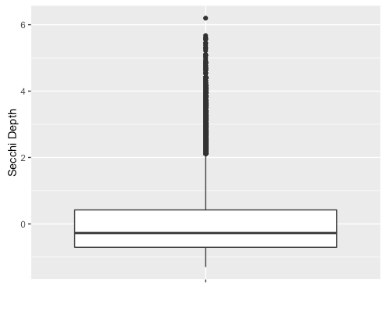
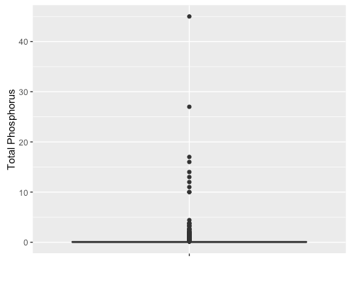
Outliers
Secchi Depth can be as high as ten
Total Phosphorus has a normal range (0.001,0.01)
0.2 regarded as big
>10 indicating anomaly (human input error)

Slide 8
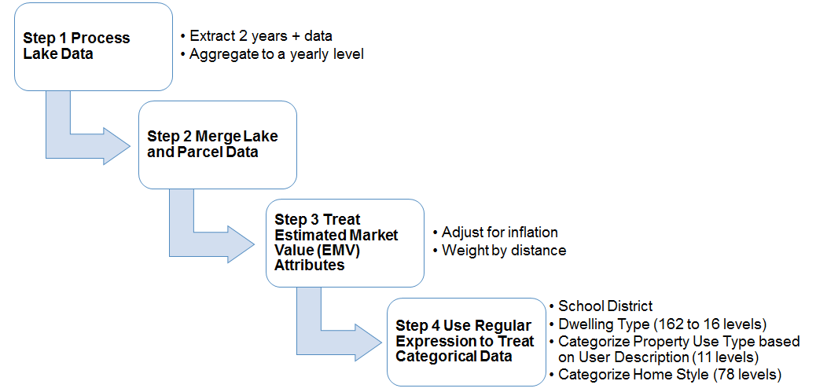


Combine lake and parcel data
Notes:
- Extract monitoring data for lakes that have at least two years of data.
- Aggregate lake data to a yearly level.
- Join lake and parcel data based on lake identifier (DNR_IT_Site_Number), parcel coordinates and year.

Slide 9
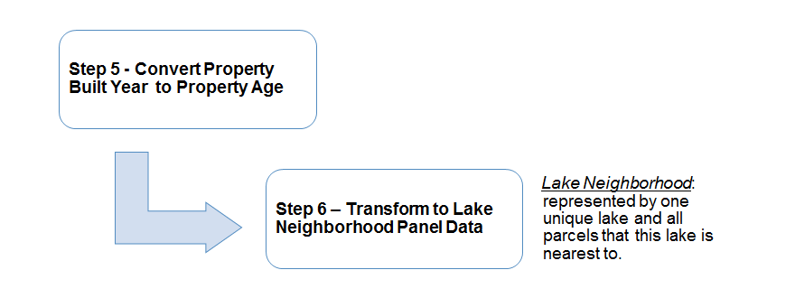
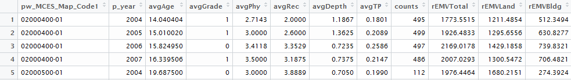
Transform to panel data for modeling
Lake Neighborhood
Water Quality (Yearly Average)
Property Attributes

Slide 10
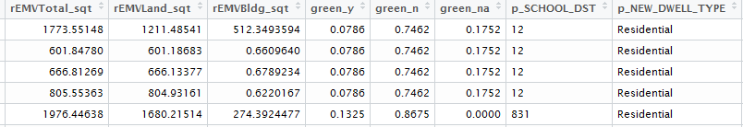
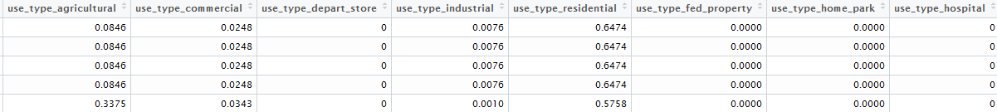
Transform to panel data for modeling
Property Attributes (Continued)
Property Attributes (Use type not included in screenprint: hotel and school )

Slide 11
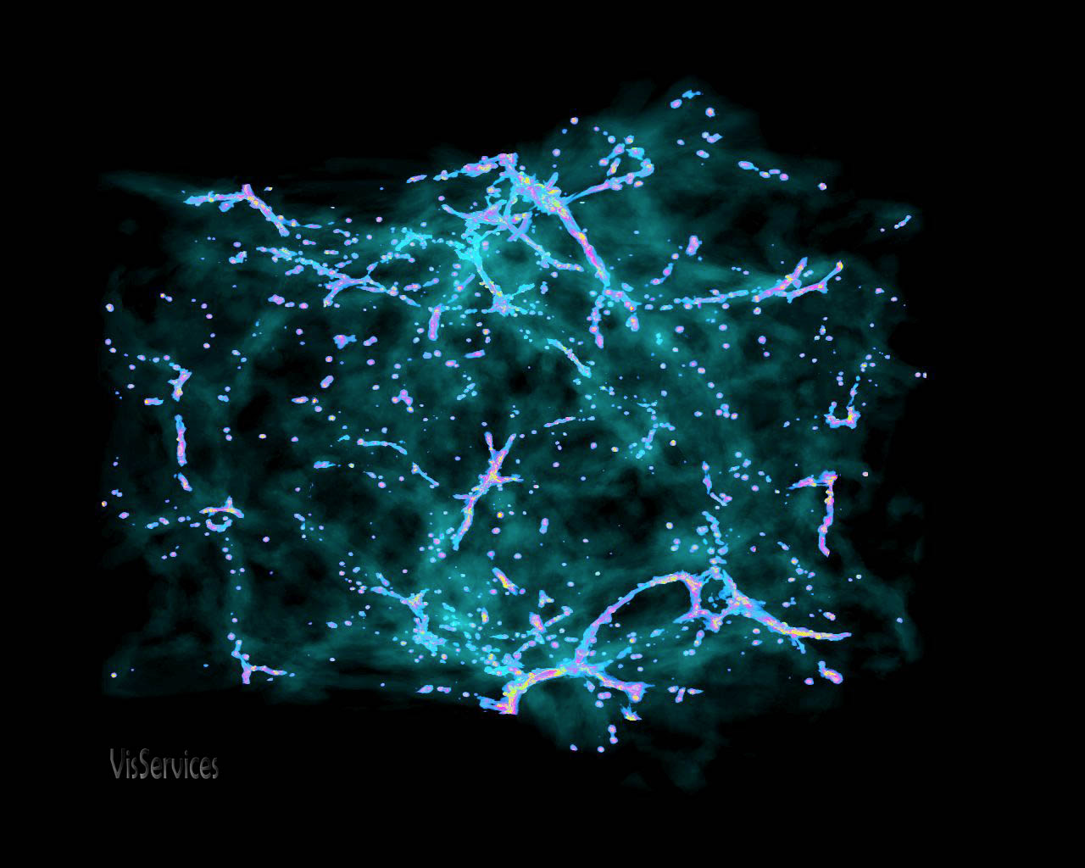
Visualization
Parcel
Random sample - 5% of data
2004 - 2014
7 Counties
Inflation-adjusted EMV

Slide 12
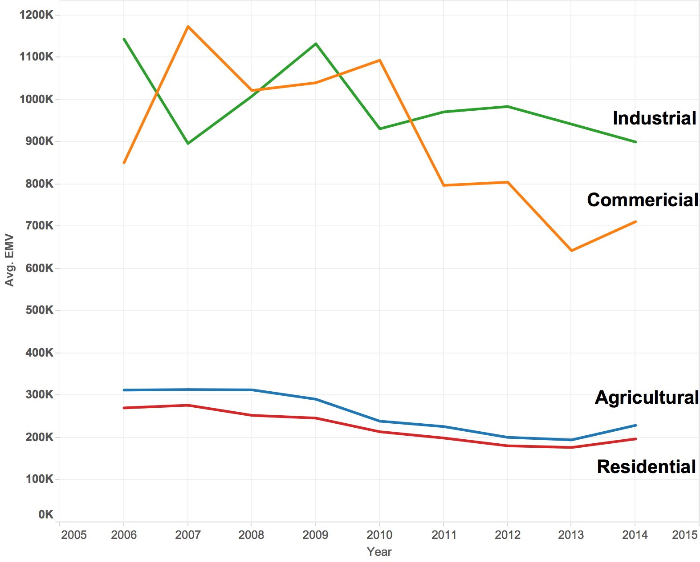
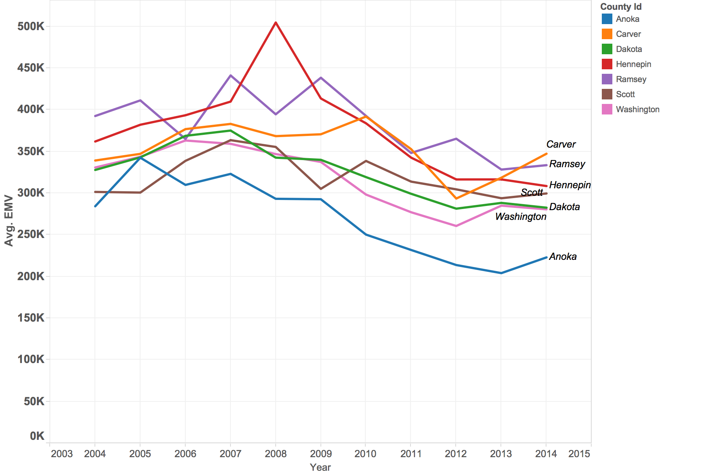
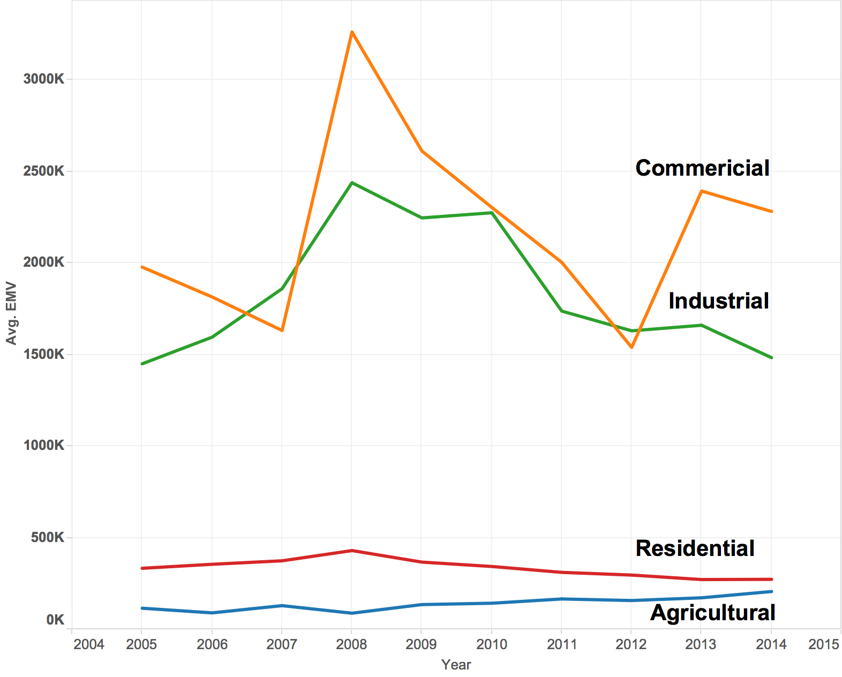
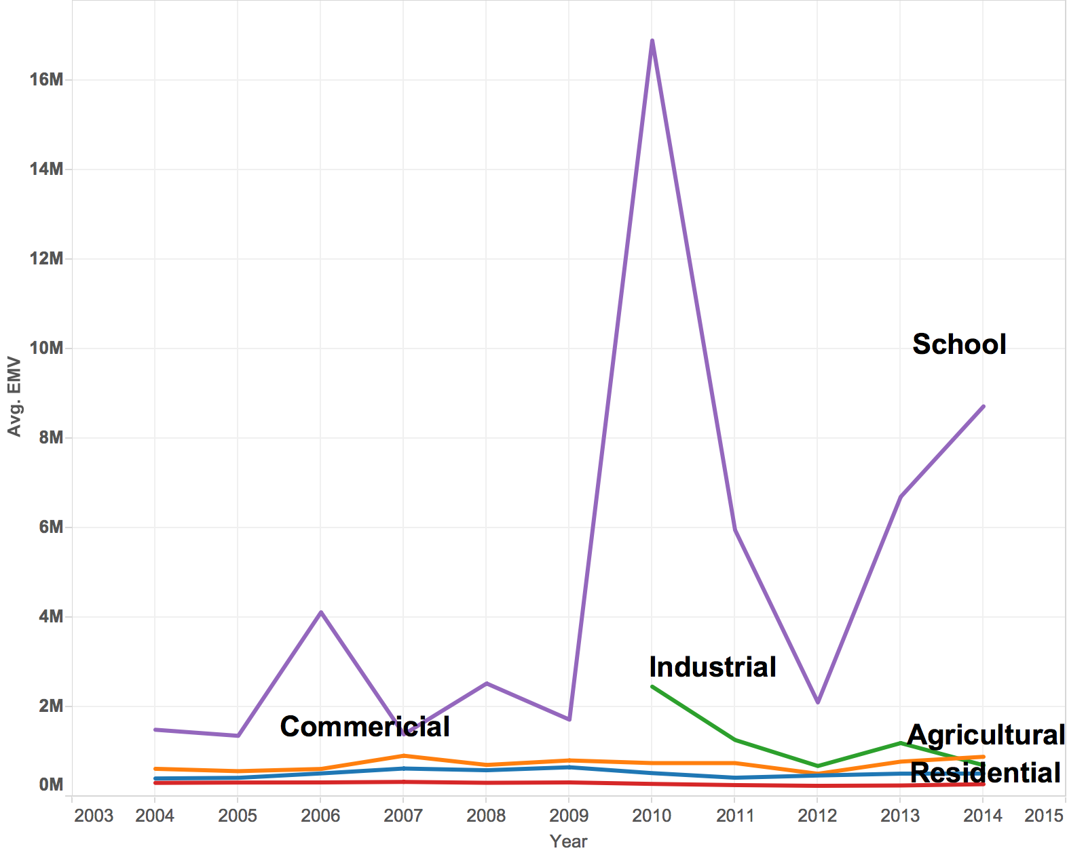
Yearly Avg EMV change in most counties declined from 2004 except for Carver
Anoka
Hennepin
Carver

Slide 13
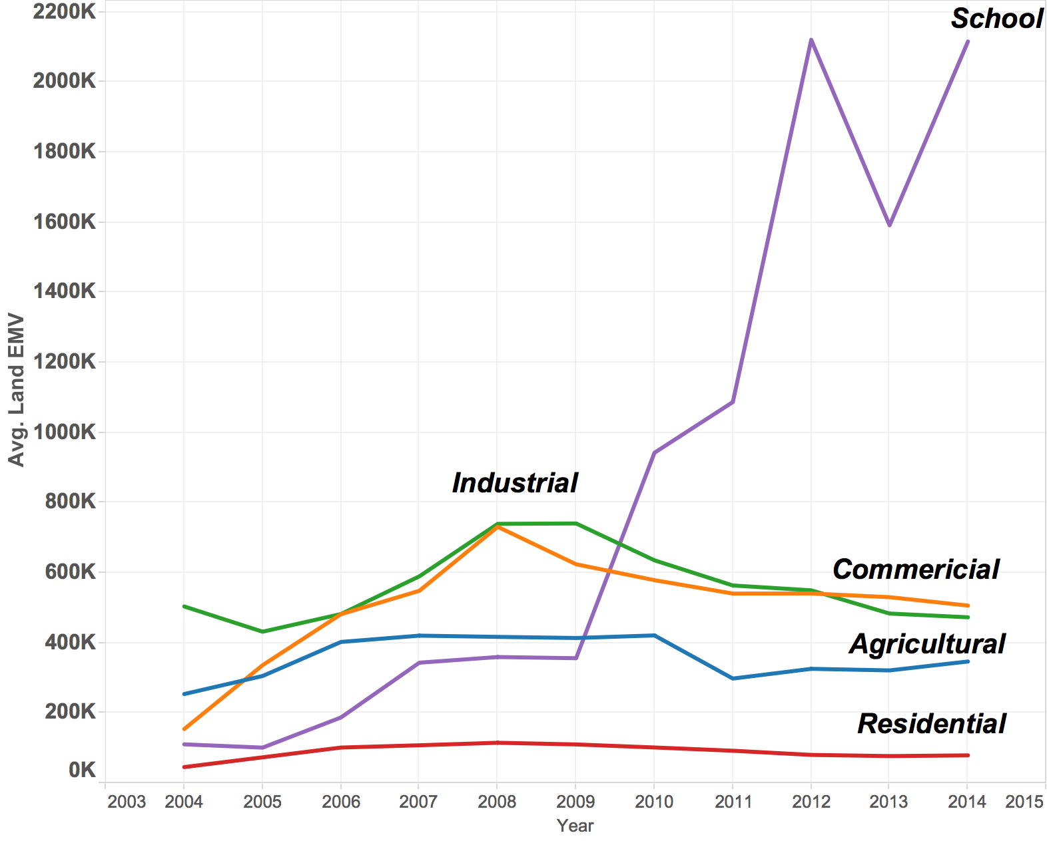
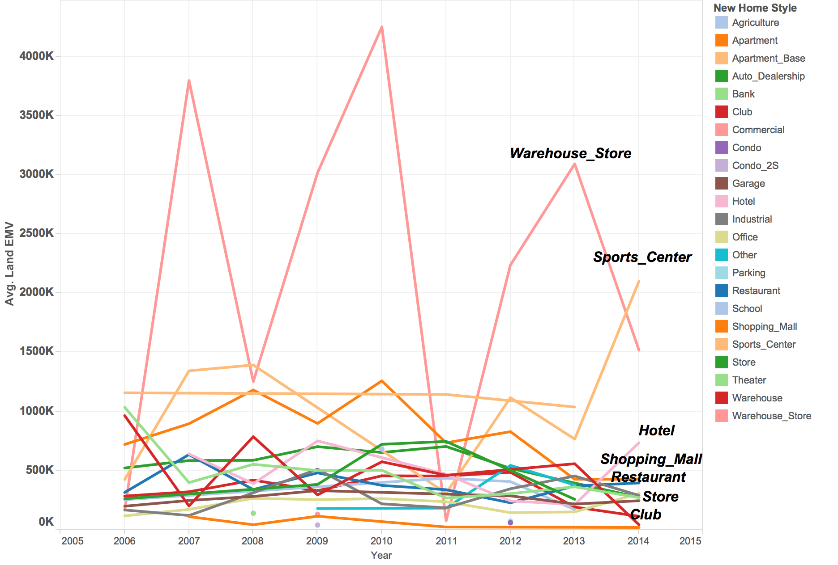
Commercial & School’s Land EMV (mostly exempt property) raised significantly
Overall
Commercial

Slide 14
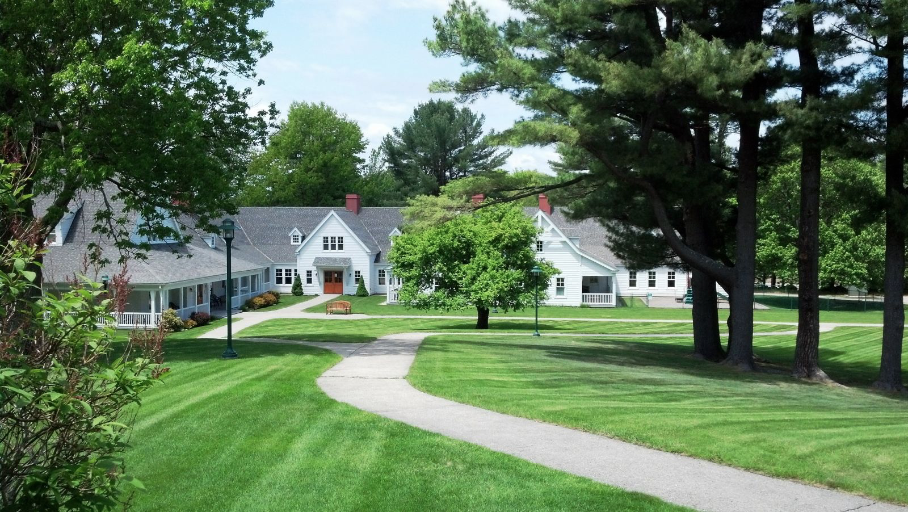
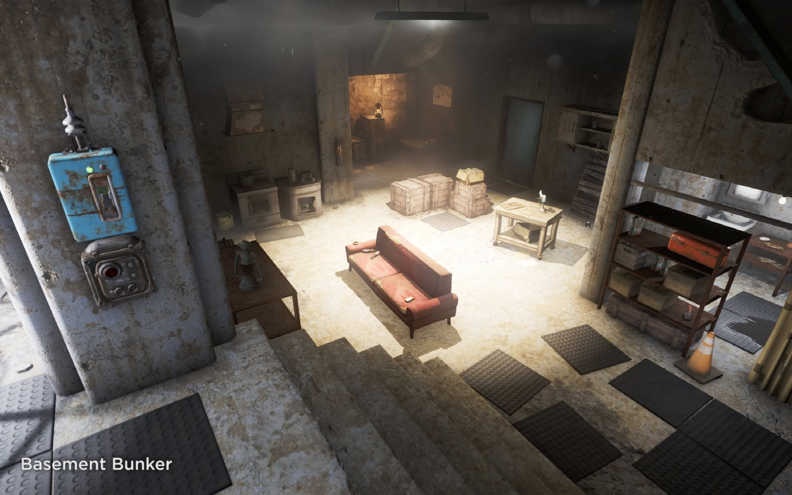
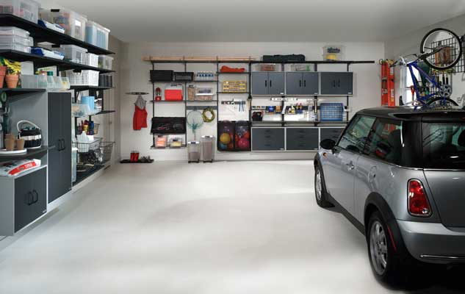
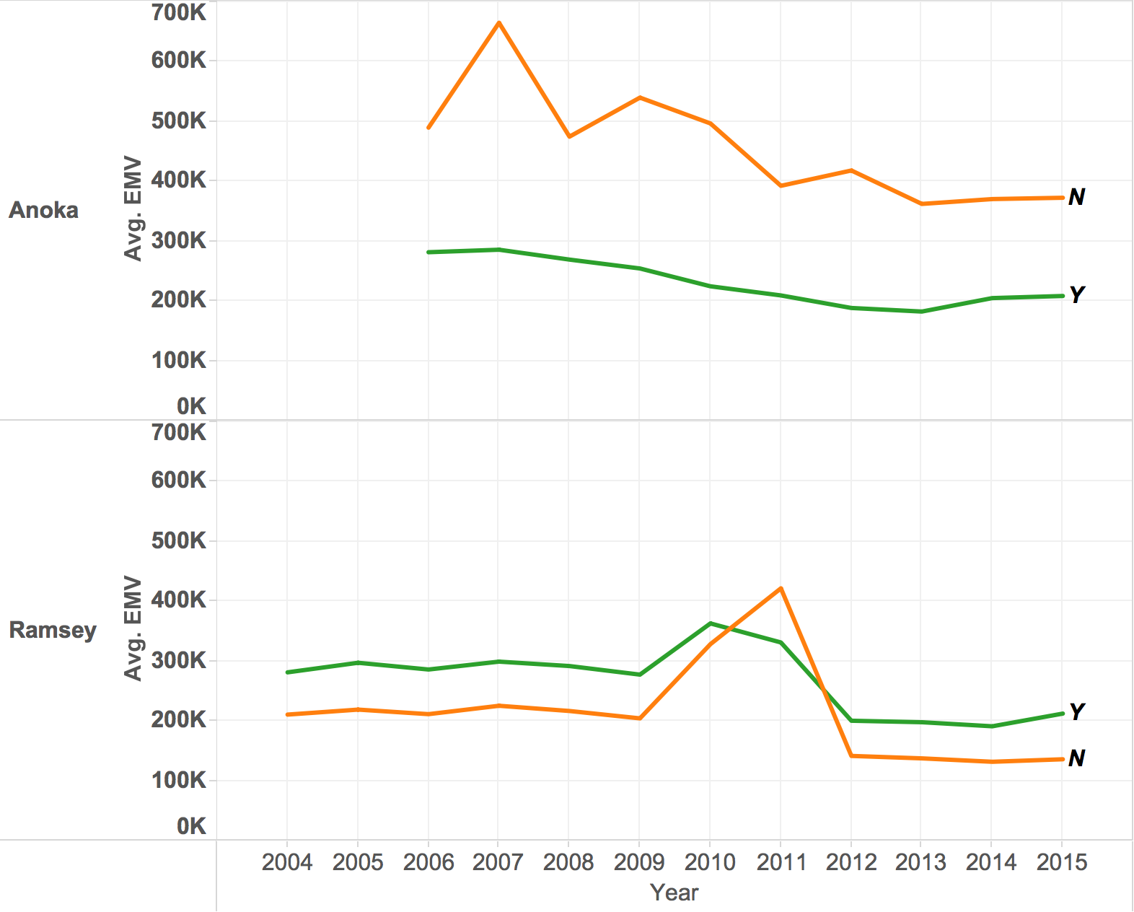
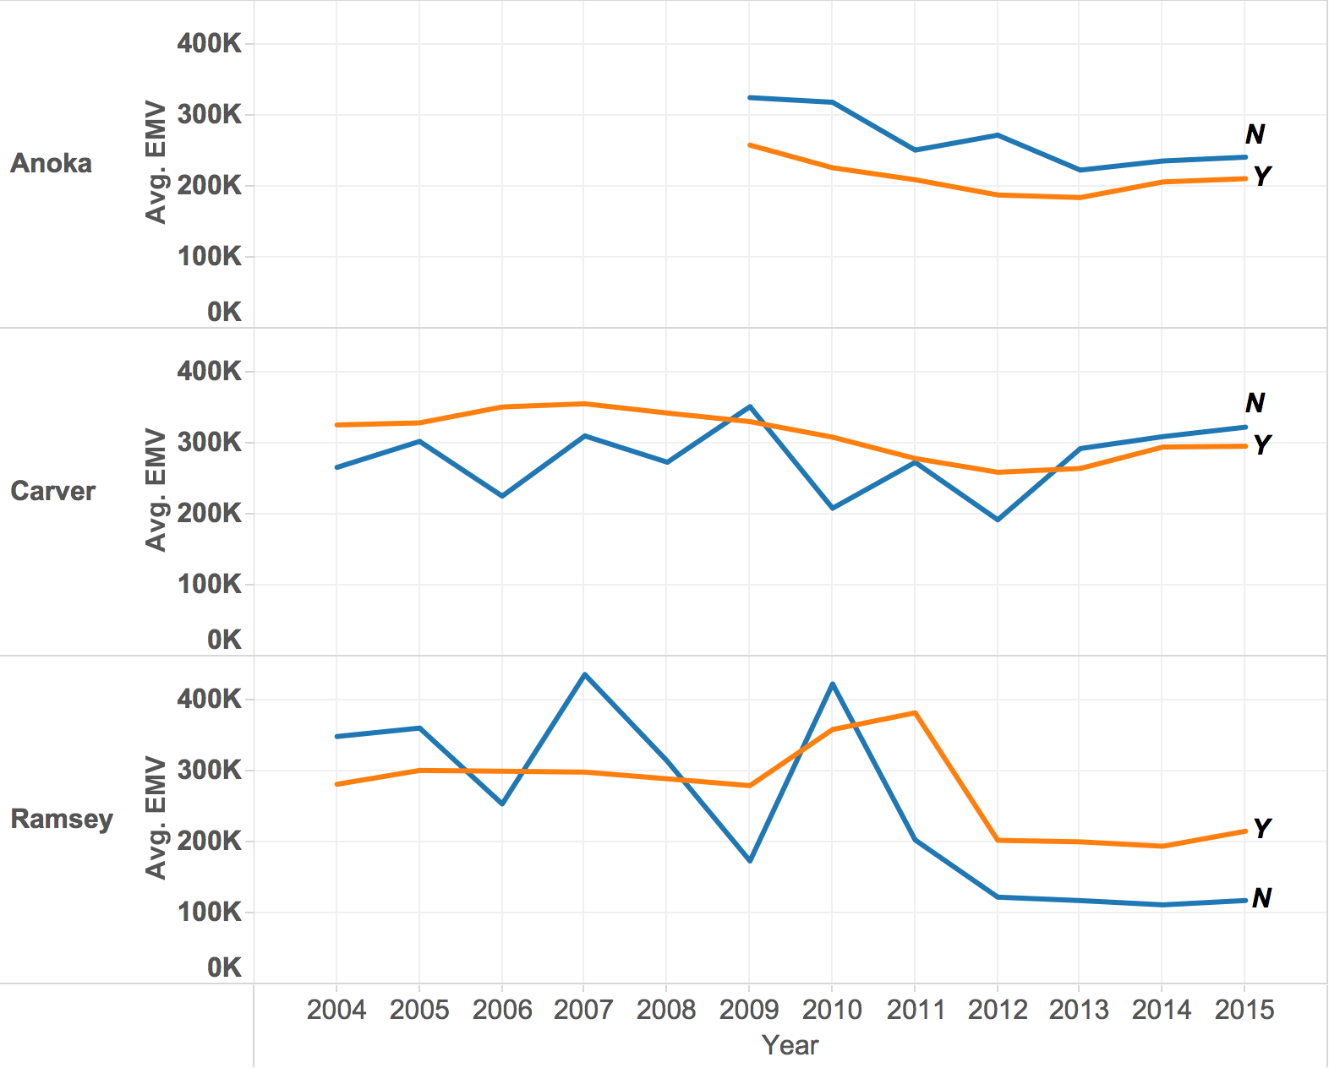
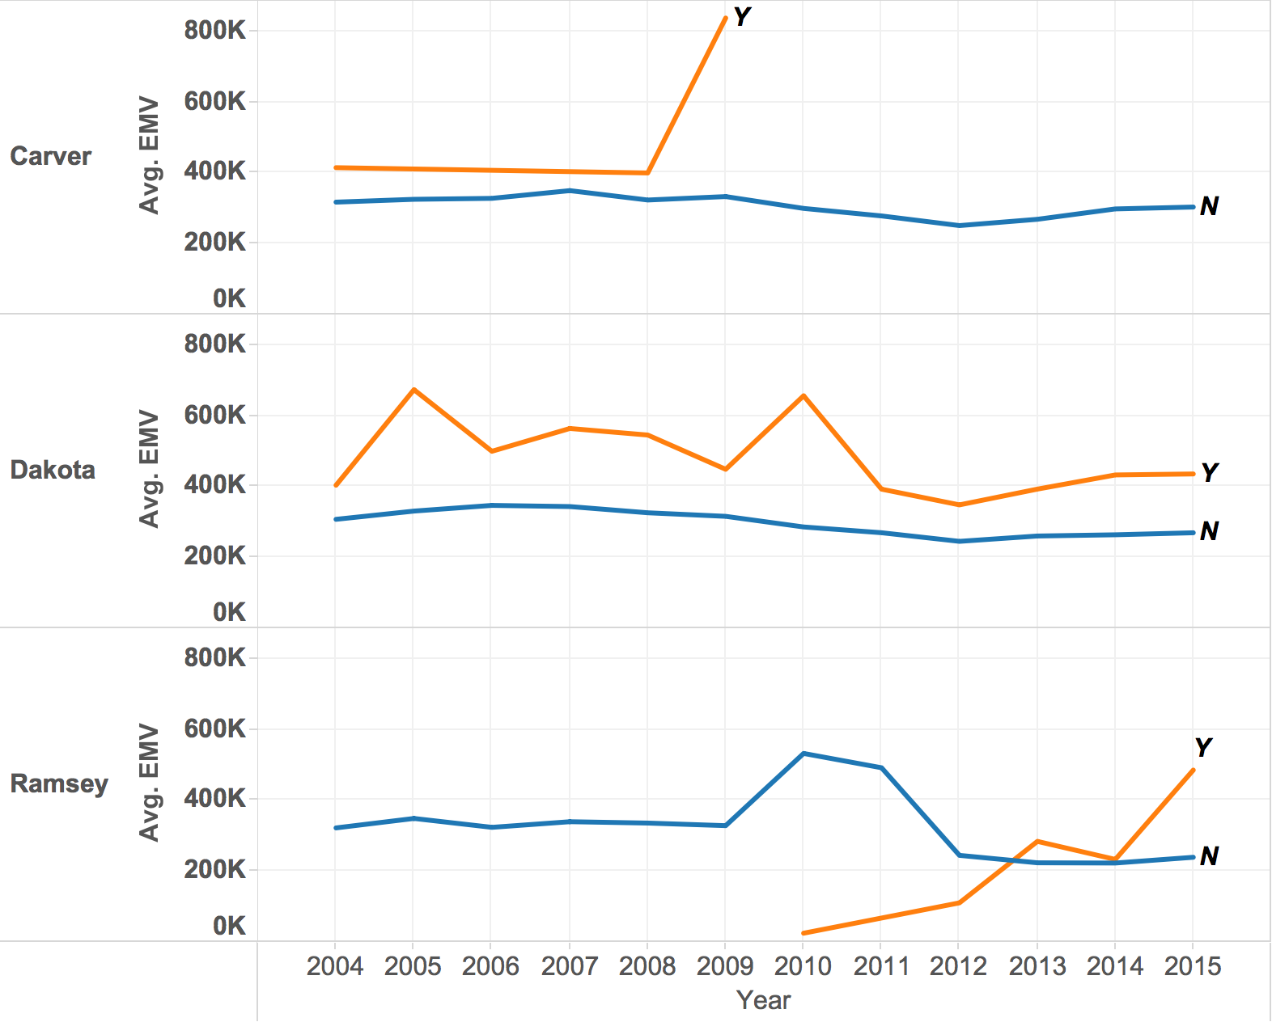
Property Characteristic & EMV

Slide 15
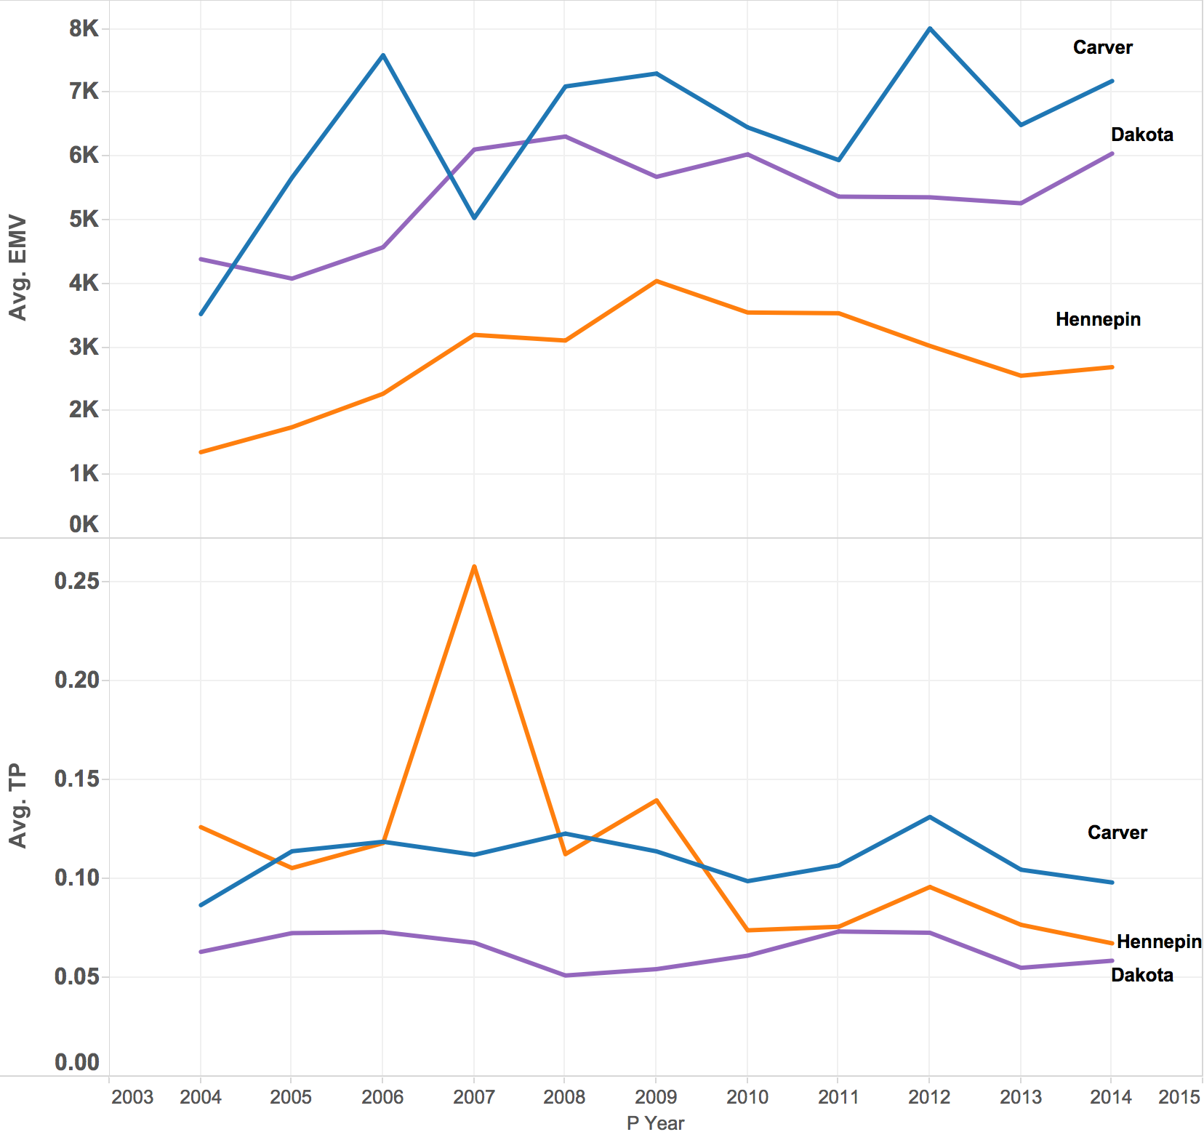
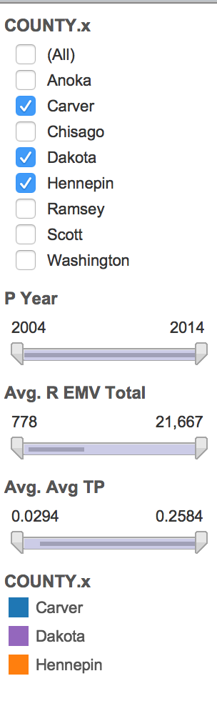

Tableau Dashboard

Slide 16
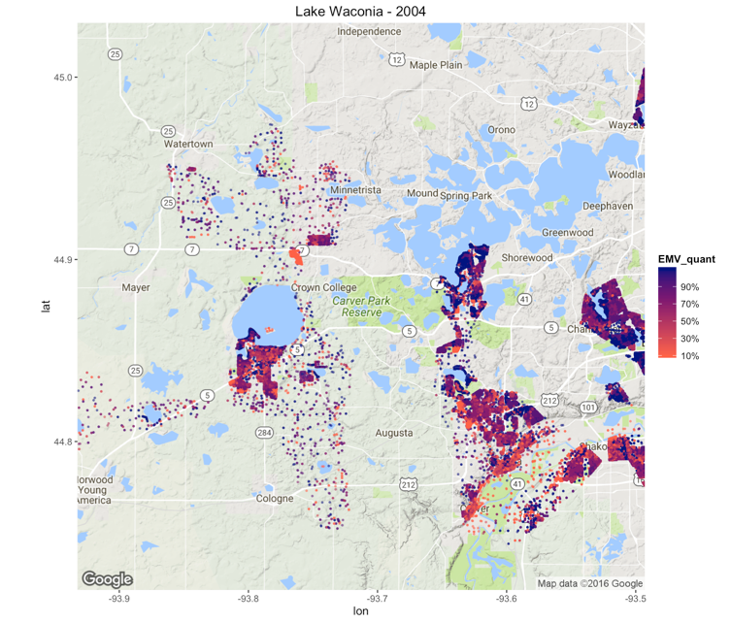
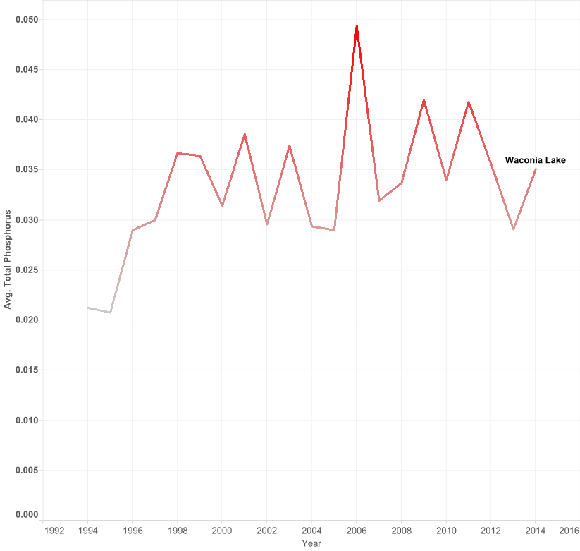
2004

Slide 17
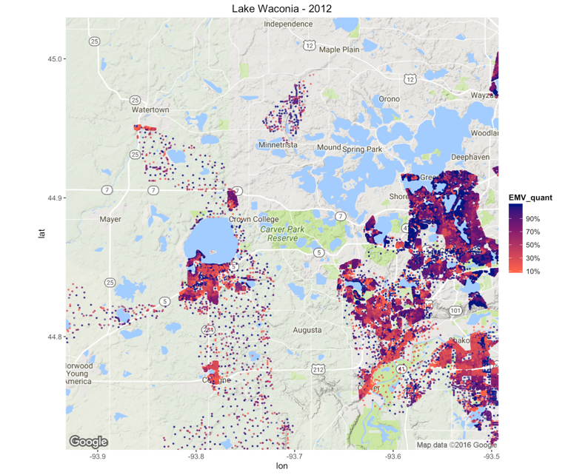
2012

Slide 18
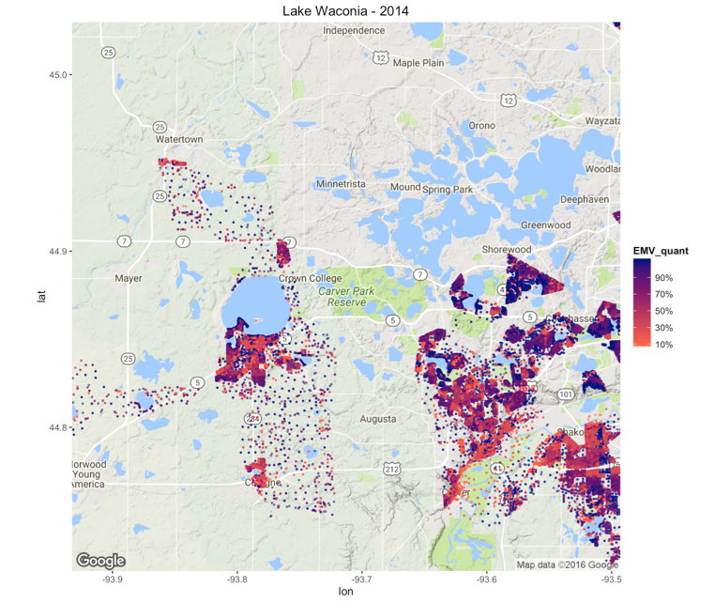
2014

Slide 19
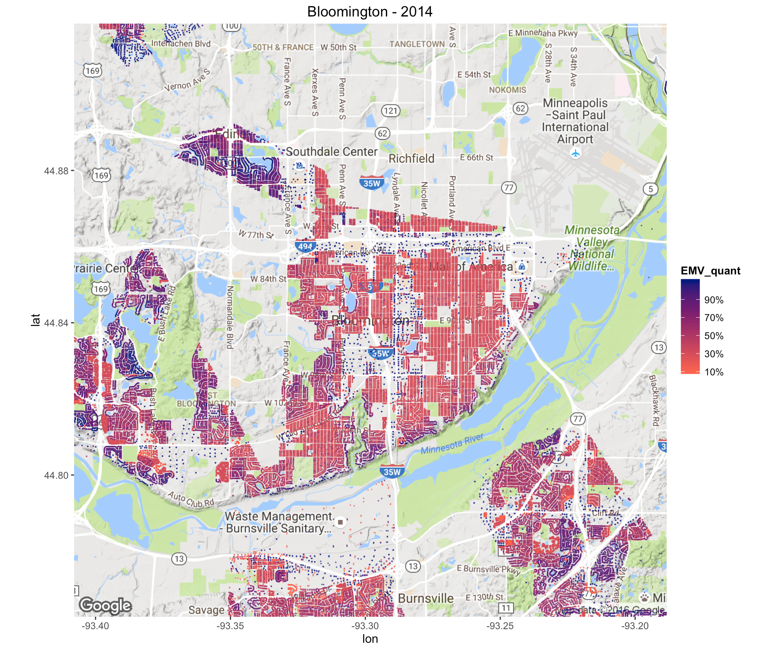
Bloomington - 2014

Slide 20
Model
max growth

Slide 21
Model Structure
Panel data of the right granularity:
Entity: Lake - Neighborhood (parcels within distance threshold with statistics weighted by distance)
Time: yearly (average of comparing months)
Assumptions:
even effect within neighborhood (except for parcels of different use type).
effects exist within a distance; longer distance -> less influences
yearly level influences with no lagged effect
Fixed effect model to control unobserved effects:
Two way fixed effect model after testing
Poolability
Individual and time effect
Random effect
Control unobserved entity and time heterogeneity

Slide 22
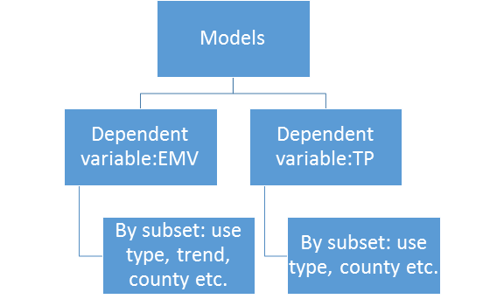
Model Structure
Models:
Attributes:
Water quality: avgTP
Economic value: EMV(coefficient interpretable)
Interactive terms and newly generated attributes
Controlled with:
time dummy variables
external lake factors (precipitation, snow)
other neighborhood factors

Slide 23
Model Structure
Effect of TP on EMV:
ml<-plm(EMVTotal ~TP+slope + tp*slope +SQ_FT+Age+use_type+dwell+school+green+nearwinter_snow, index = c("entity","year"), model = "within",effect="twoways")
Effect of EMV on TP:
m2<-plm(TP ~ TP_lag+PRCP+nearwinter_snow+EMV_Total_agr + EMV_Total_com + EMV_Total_ind + EMV_Total_res, index = c(“entity”, “year”), model =
"Within", effect = "twoways")
Notes:
Global model:
ml<-plm(EMVTotal~TP+slope+SQ_FT+Age+use_type+dwell+school+green+nearwinter_snow+
tp*slope,data=data,index = c("entity","year"),model, "within",effect="twoway")
m2<-plm(TP~TP_lag+PRCP+nearwinter_snow+EMV_Total_agr + EMV_Total_com + EMV_Total_ind + EMV_Total_res, index = c(“neighbor”, “year”), model =
"Within", effect = "twoways")

Slide 24
EMV effect on TP
m2<-plm(TP~TP_lag+PRCP+nearwinter_snow+EMV_Total_agr + EMV_Total_com + EMV_Total_ind + EMV_Total_res, index = c(“neighbor”, “year”), model =
"Within", effect = "twoways")
Distance X Use Type
County/ Watershed
X Use type
<200m:
200-400m
400-800m
800-1000m:
1000-1500m:
Washington 622
Carver 227
Dakota 221
Hennepin 168
Scott 70
Anoka 53
6 watershed
Lower St. Croix River 502
Lower Minnesota River 432
Mississippi River - Twin Cities 362
Mississippi River - Lake Pepin 74
South Fork Crow River 27

Slide 25
Insight & Recommendation

Slide 26
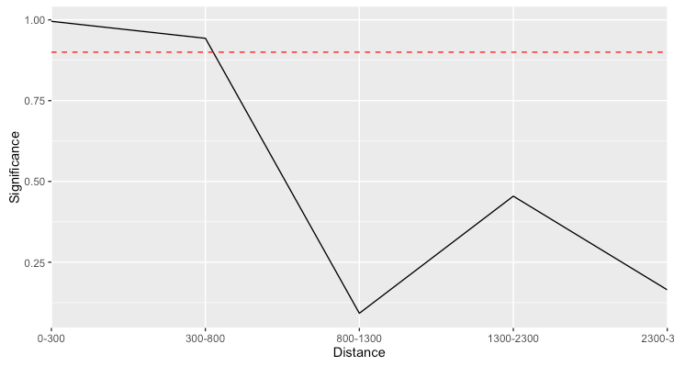
1. Distance sensitivity analysis
TP on EMVTotal
EMV on TP:
<200m:
commercial +
200-400m:
commercial +
residential +
800-1000m:
Residential +
1000-1500m:
No effect
Correlation between water quality and neighbor estimated market value is significant within 800 meter.
The impact distance of commercial and Residential on lake are significant within 400 meter and 1000 meter respectively.

Slide 27
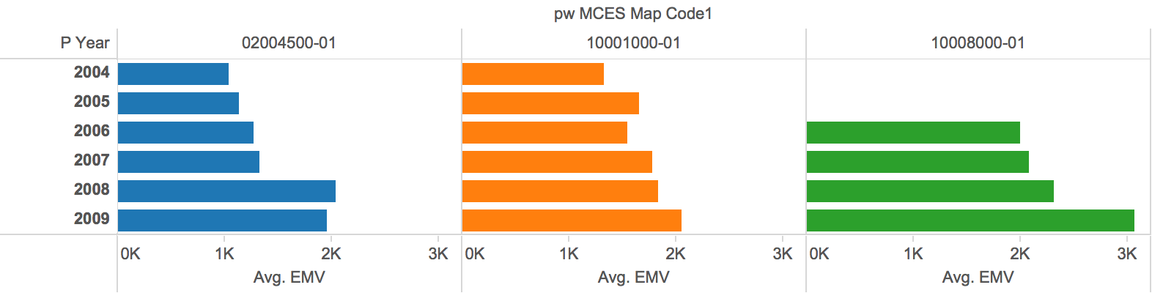
2. Dramatic TP decrease~ EMV increase
Model: EMV~TP
Slope range | Estimate | Pr(>|t|)
[-0.9,0.89]/slope*TP | -5.672e+04 | 0.011051
[-0.9,-0.52]/TP | 8.986e+04 | 0.00552
Investment in worse lake to improve water quality could significantly increase the property's estimated market value.

Slide 28
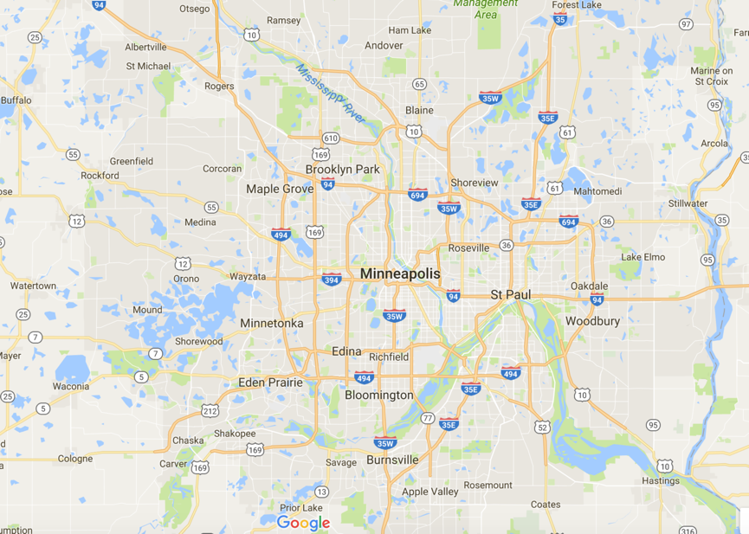
3. School
Model | Estimate | Pr(>|t|)
EMV~TP | 1.997e+04 | 0.065970
Lake being accessed by human (TP increases)
wealth comes first, school EMV increase.

Slide 29
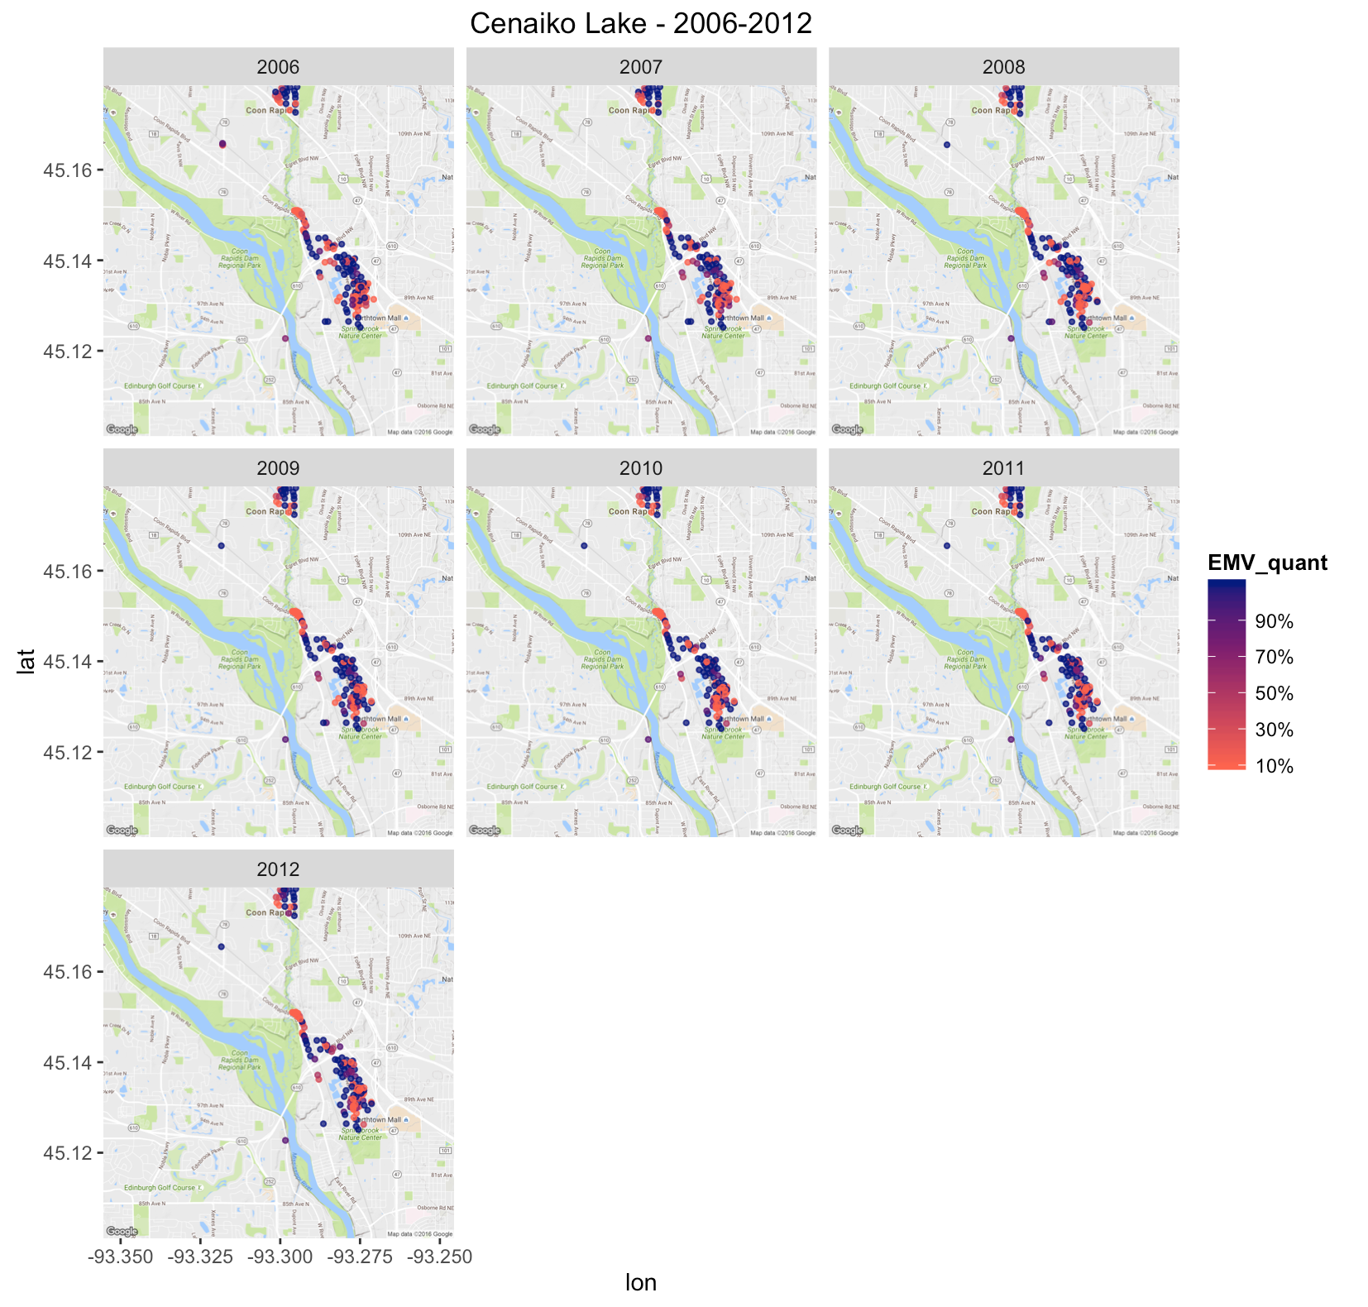
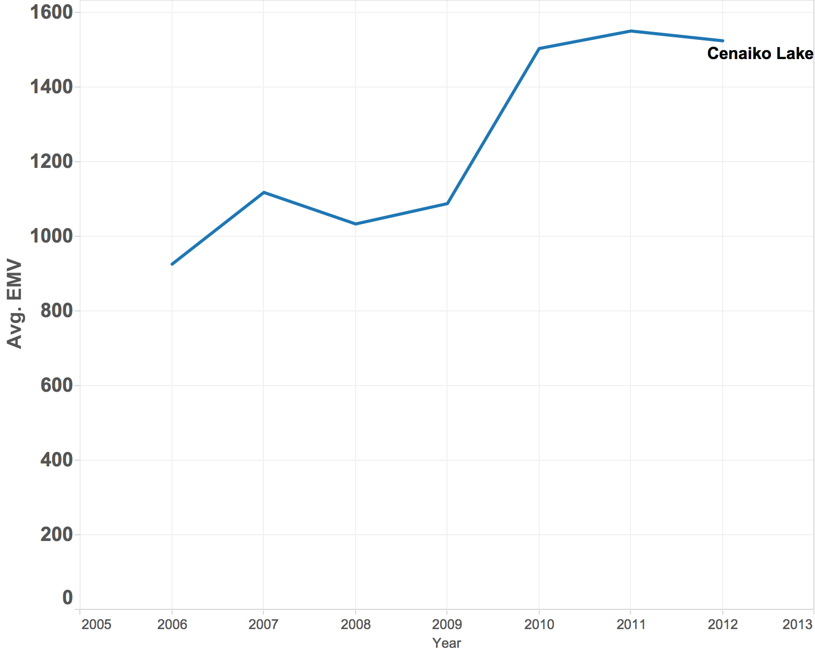
4. Industry developing~did not increase TP
TP slope 0.54
Model | Estimate | Std. Error | t value | Pr(>|t|) | Adjusted R2 | AIC
EMV~TP | 1.641e+04 | 6.198e+03 | 2.647 | 0.00875 | 0.9608 | 4770.552
TP~EMV

Slide 30
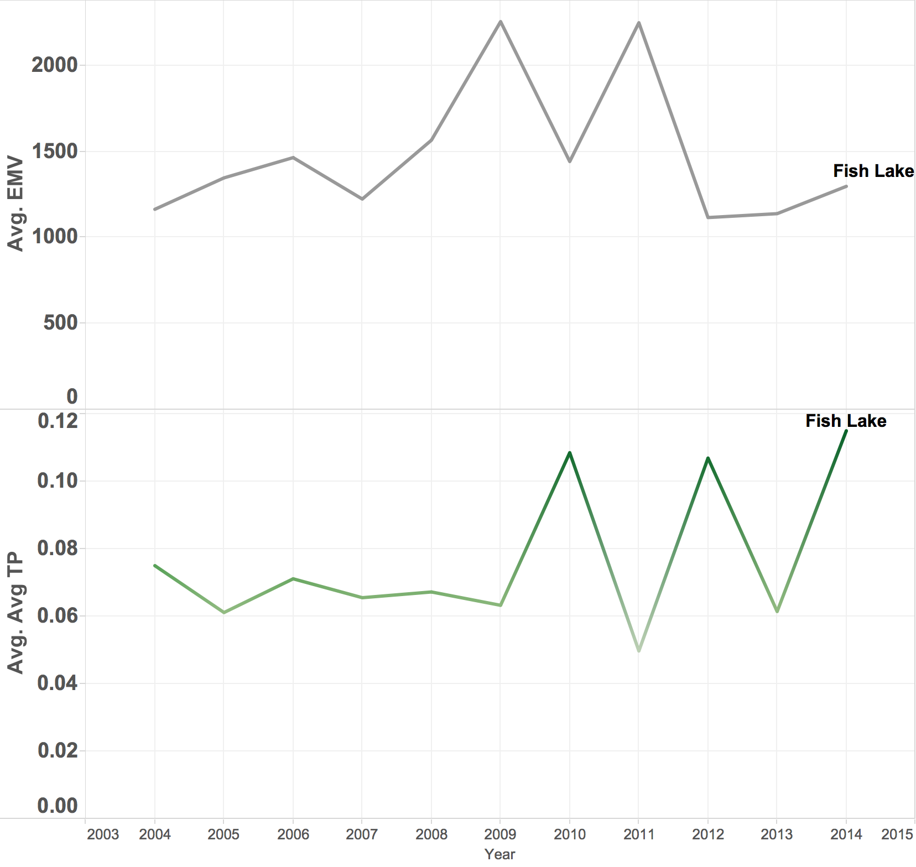
5. Agricultural developing~increased TP
Hennepin:
Increased agriculture EMV & deteriorated TP (higher marginal cost)
Washington, Lower St. Croix River
Reduced agriculture EMV & TP improvement
TP~EMV | Estimate | Pr(>|t|)
Hennepin | 2.1158e-03 | **
Washington | 1.2231e-06 | *
Washington | 1.8304e-06 | **

Slide 31
Thanks!

Slide 32
Appendix

Slide 33
Data Transformation Using Regular Expression
Use Regular Expression to Treat Categorical Data:
Clean up School District values using Regular Expression
i.e. ISD214 -> 214
Reduce Dwelling Type Categories (162 to 16 levels)
i.e. Industrials, Heavy Mftg. -> Industrial
Categorize Property Use Type based on User Description (11 levels)
i.e. Apartment -> Residential, College-Public -> School
Categorize Home Style (78 levels)
i.e. High School -> School

Slide 34
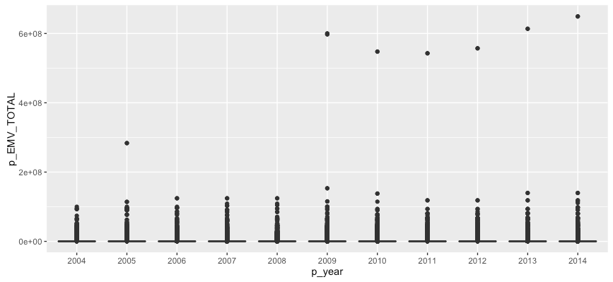
Outlier
Mall of America’s estimated market value is 60 millions
Remove those distant points

Slide 35
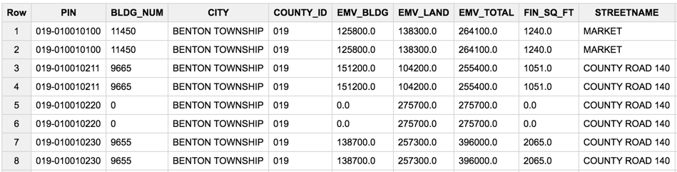
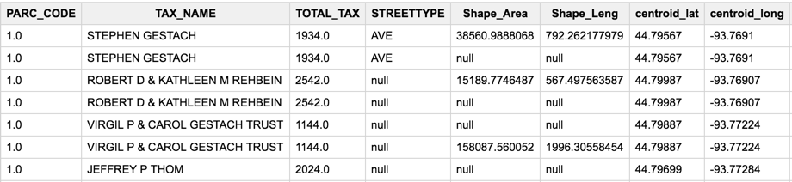
Duplicates

Slide 36
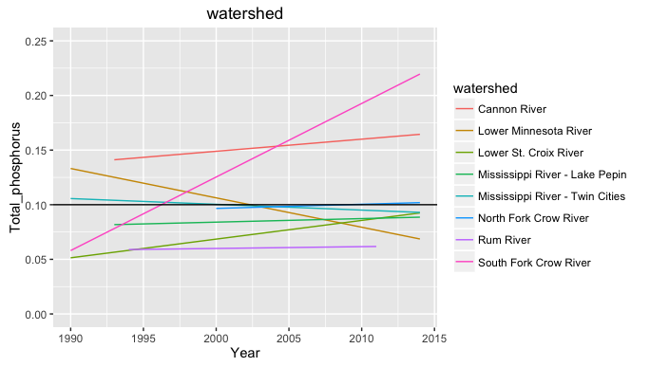
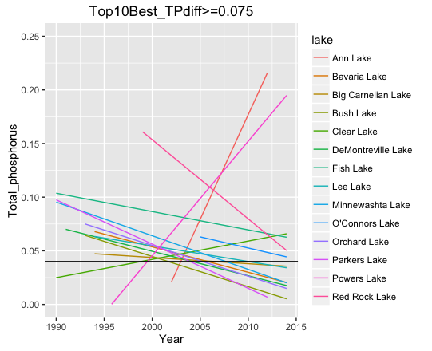
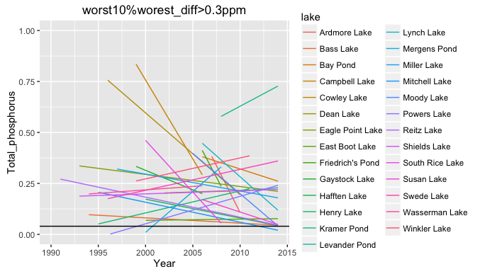
School District
Notes:
Lake

Slide 37
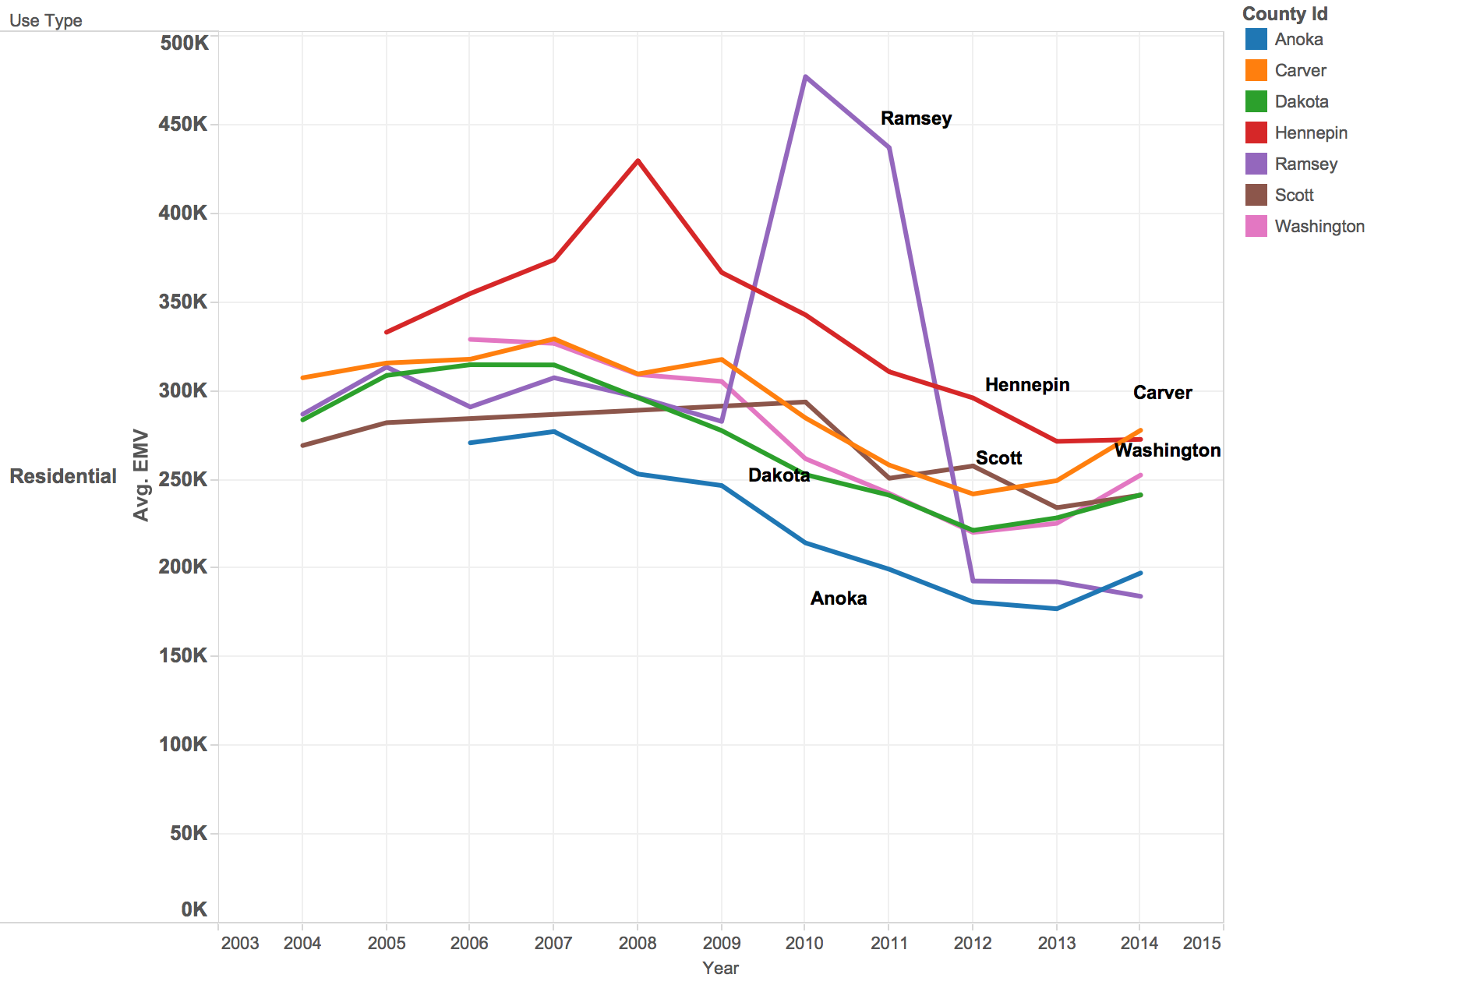
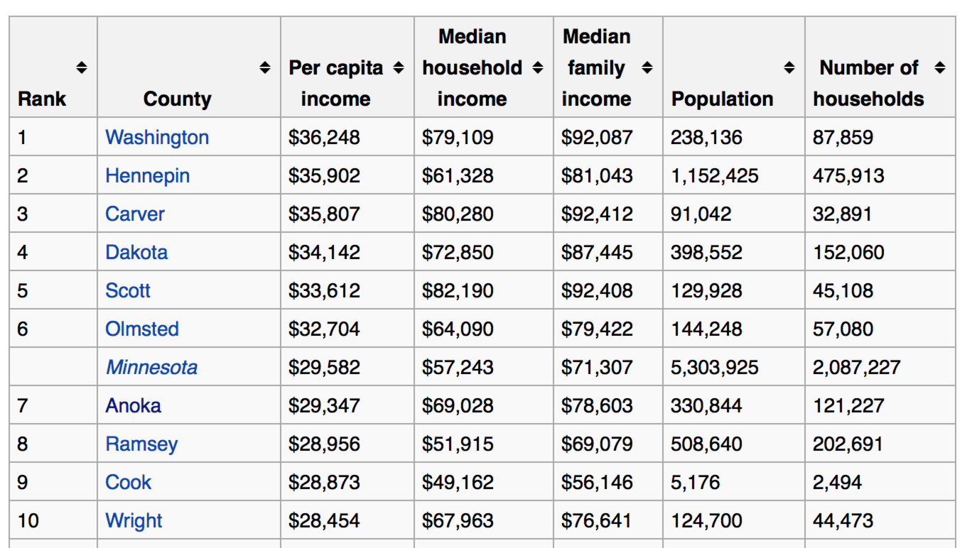
Residential Avg EMV corresponds to the median household income

